Slide 1
Session 2
House Keeping
Homework file naming convention:
LastNameAssignemtnNameAndNumber.zip
Zipped file
More details to follow with each assignment
Suggested book
Microsoft SQL Server 2008 R2 Unleashed
0672330563
Microsoft® SQL Server® 2008 T-SQL Fundamentals
8178531046

Slide 2
Data Normalization
Data Normalization
Minimize redundancy
Simplify relationships
Remove aggregation
Remove repetitive information
Create smaller more manageable components
Define relationship between tables
Manageable additions deletions and modifications
Increase performance of database

Slide 3
Data Normalization
Normalize data type usage
Standardize data types
Normalize logical and physical aspects
Standardize naming conventions
Describe data types and data tables
Describe data usage

Slide 4
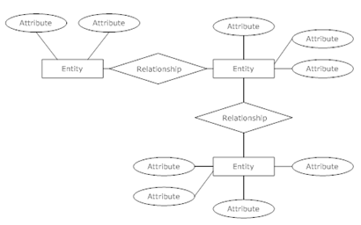
Data Normalization
ERD Entity Relationship Diagram
Entities, Relationships, and Attributes

Slide 5
Data Normalization
Reading proactively: focus on nouns
Find Entities First
Example:
We need to create a database that will contain data about classes, teachers and students. Additionally, this database will contain all information about student registration, class information and teacher assignments for each semester.

Slide 6
Data Normalization
Entities:
We need to create a database that will contain data about classes, teachers and students. Additionally, this database will contain all information about student registration, class information and teacher assignments for each semester.

Slide 7
Data Normalization
Relationship:
M:M
M:M
Class
Teacher
Student
M:M
M:M
Registration
Information
Assignment

Slide 8
Data Normalization
Relationship:
1:1
1:M
M:M

Slide 9
Class
Info
1:M
Student
Info
M:1
Teacher
Info
1:M
Registration

Slide 10
Class
Info
Attributes
Relationships
Registration
Class ID
Class Name
Class Description
Registration ID
Class ID
Student ID
Teacher ID
Class Date
Student
Info
Teacher
Info
Student ID
Student Name
Student SS#
Address
Teacher ID
Teacher Name
Teacher SS#
Address

Slide 11
Entity and Attributes
Class ID
Class ID
Class Name
Class Description
Class Name
Class
Info
Class Description

Slide 12
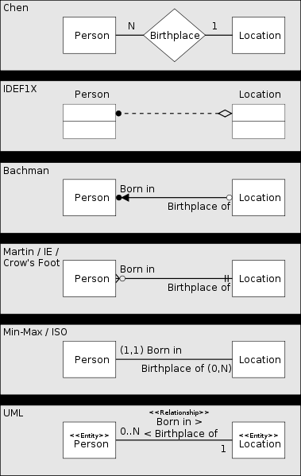

Slide 13
6 Normal Forms
1NF
2NF
3NF
4NF
5NF
6NF

Slide 14
ERD
Table 1
Table 2
Table 1
Table 2
1
M
Table 1
Table 2

Slide 15
NFs
Table Name 1
Table Name 2
Table ID1
Attribute 1
Attribute 2
Attribute 3
Table ID2
Tabl_ID1
Attribute 1
Attribute 2
- Provide Table Name
- Provide Bolded Underlined Primary Key
- Clear distinction 1:M relationship
- 3NF

Slide 16
6 NF
1NF
Eliminate repeating groups in individual tables.
Create a separate table for each set of related data.
Identify each set of related data with a primary key.
2NF
Create separate tables for sets of values that apply to multiple records.
Relate these tables with a foreign key.

Slide 17
6 NF
3NF
Eliminate fields that do not depend on the key.
4NF, 5NF, 6NF
Deal with further data purification
Capture real life scenarios
Fourth and fifth normal forms are also about composite keys. These normal forms attempt to minimize the number of fields involved in a composite key
Deal with Parent Child relationship

Slide 18
NFs
Class
Class ID
Class Name
Class Description
Student
Student ID
Student Name
Student SS#
Address
Registration
Registration ID
Class ID
Student ID
Teacher ID
Class Date
Teacher
Teacher ID
Teacher Name
Teacher SS#
Address

Slide 19
NFs
Student
Student ID
Student Name
Student SS#
Address
Person
Person ID
Person Type ID
Person Name
SS#
Teacher
Teacher ID
Teacher Name
Teacher SS#
Address
Person Type
Person Type ID
Person Type Description

Slide 20
NFs
Student
Student ID
Student Name
Student SS#
Address
Address
Address ID
Person ID
Address Type
Street
City
State
Zip
Address Type
Address Type ID
Address Type Description
Primary
Mailing
School building
Teacher
Teacher ID
Teacher Name
Teacher SS#
Address

Slide 21
Class
Class ID
Class Name
Class Description
Registration
Registration ID
Class ID
Person ID
Person Type ID
Semester ID
Address ID
Person
Person ID
Person Type ID
Person Name
Active ID
SS#
Semester
Semester ID
Semester Desc
Person Type
Person Type ID
Person Type Desc
Address Type
Address Type ID
Address Type Desc
Address
Address ID
Address Type ID
Street
City
State
Zip
HR
HR ID
Person ID
Address ID
Last Updated

Slide 22
Example
We need to extend current module to include grades for the class.

Slide 23
Class
Class ID
Class Name
Class Description
Registration
Registration ID
Class ID
Person ID
Person Type ID
Semester ID
Address ID
Grade ID
Person
Person ID
Person Type ID
Person Name
Active ID
SS#
Semester
Semester ID
Semester Desc
Person Type
Person Type ID
Person Type Desc
Address Type
Address Type ID
Address Type Desc
Address
Address ID
Address Type ID
Street
City
State
Zip
HR
HR ID
Person ID
Address ID
Last Updated
Grade
Grade ID
Grade Desc

Slide 24
Example
We need to extend current table to include date of the semester.

Slide 25
Example
Semester
Semester ID
Semester Start Date
Semester End Date
Semester Type
Semester Type ID
Semester Descr

Slide 26
Importance of Normalization
Registration
Registration ID INTEGER
Class ID INTEGER
Person ID INTEGER
Person Type ID INTEGER
Semester ID INTEGER
Address ID INTEGER
Grade ID INTEGER

Slide 27
Importance of Normalization
Class
Class ID INTEGER
Class Name VARCHAR
Class Description VARCHAR

Slide 28
Exercise
We have to set up a database to deal with any sporting event. We must keep track of teams, score, managers, players, matches. We assume 2 teams can play each other at the same time. Team can have unlimited number of players, team can have an unlimited number of coaches and managers, match can have winner, looser or tie.

Slide 29
Exercise
We have to set up a database to deal with any sporting event. We must keep track of teams, score, managers, players, matches. We assume 2 teams can play each other at the same time. Team can have unlimited number of players, team can have an unlimited number of coaches and managers, match can have winner, looser or tie.

Slide 30
Person Type
Team
Person
Match Type
Game

Slide 31
Team
TeamID
TeamName
Roster
RosterID
TeamID
PersonID
PersonTypeID
Person
PersonID
PersonName
PersonType
PersonTypeID
PersonTypeDesc
Match
MatchID
MatchDesc
MatchDate
MatchStats
MatchStatsID
MatchID
Team1RosterID
Team2RosterID
Team1Schore
Team2Schore
MatchStats
MatchStatsID
MatchID
RosterID

Slide 32
Team
TeamID
TeamName
Roster
RosterID
TeamID
PersonID
PersonTypeID
Person
PersonID
PersonName
PersonType
PersonTypeID
PersonTypeDesc
Match
MatchID
MatchDescID
MatchDate
MatchStats
MatchStatsID
MatchID
Team1RosterID
Team2RosterID
Team1Schore
Team2Schore
MatchDate
SchoreBoard
SchoreBoardID
MatchStatsID
TeamID
PersonID
SchoreMinute
TypeOfSchoreID
TypeOfSchore
TypeofSchoreID
TypeofSchoreDesc
MatchDesc
MatchDescID
MatchDesc
MatchStats
MatchStatsID
MatchID
RosterID
MatchDate

Slide 33
Homework
You are a CIO of a XYZ.Com firm. You have to design a database for your firm. Your firm is an IT consulting firm. You have your employees such as developers, project managers, consultants. You have your customers such as other firms or individuals. You have specific contacts at the firm. Firms can have many projects. There can be many employees per project. There can be multiple contacts per project. There are delivery dates per project. Employees can be active or inactive. Projects can be finished, in progress or planned.

